Slide 1


















Mayur Gawand
20162014
Bhavesh Gharat
20162015
Tejas Gole
20162037
Kiran Vawale
20162064
Guide Prof.V.N.Patil
Pillai HOC College Of Engineering & Technology
TEST CERTIFICATION FOR GREEN HYDROGEN
PRODUCTION PLANT EQUIPMENTS
Presentation:- SHANTANU PATIL
Guide: Prof. ATUL JADE
DEP. MECHANICAL ENGINEERING
UTPNN GREENTECH PVT. LTD

Slide 2


To provide refrigeration in rural areas where continuous electricity supply is not available
To reduce harmful effect of refrigerant by making refrigerant free environmental friendly refrigeration system using Peltier module
To make cost effective refrigerator for small application use
CONTENTS
OBJECTIVES
INTRODUCTION
QUALTY CONTROL OF EQUIPMENT
LITERATURE REVIEW
COMPONENTS
6. PROCESS OF CERTIFICATION
7. CODES AND STANDARDS FOR
EQUIPMENTS
8. RESULTS
9. REFERNCES

Slide 3


OBJECTIVES
1. The main objective of this project is to Ensure equipment meets safety, quality & performance standards.
3. To verify the quality of the green hydrogen produced, demonstrate its sustainability, provide quality assurance & reduce greenhouse gas emissions.
2. To Ensure quality control, reliability & efficiency.

Slide 4
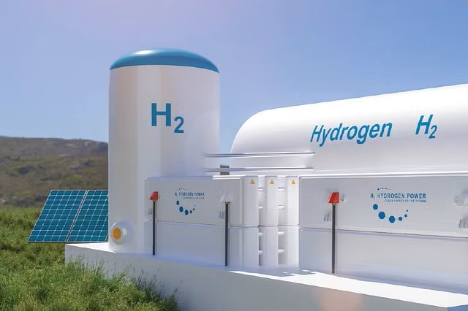
Mayur Gawand
20162014
Bhavesh Gharat
20162015
Tejas Gole
20162037
Kiran Vawale
20162064
Guide Prof.V.N.Patil
INTRODUCTION
Test certification for green hydrogen production plant equipment is crucial for ensuring quality and sustainability.
There are various types of methods for producing hydrogen i.e. electrolysis method, steam methane reforming, biomass gasification, partial oxidation, thermochemical water spitting
A test certificate serves as a stamp of approval, verifying that the equipment meets specific quality, safety, and performance standards.
The certification process defines the quality and service life of electrolyzer systems, and establishes safe production under renewable energy sources
Importance Of Certification:
Ensures equipment is reliable, efficient, and safe for use.
Provides confidence to users, investors, and regulators

Slide 5

QUALITY CONTROL OF EQUIPMENT
Quality control means making sure that the equipment used in green hydrogen production meets specific standards. It ensures that the equipment is reliable, safe, and performs as expected.
Also high quality of hydrogen is produced efficiently & safely while minimizing the environmental impact.
Parameters | Description
Material Selection | Choose corrosion-resistant materials for equipment. Materials must withstand chemical reactions in hydrogen production.
Pressure Testing | Test equipment for high-pressure capabilities. Ensure it can handle the pressures involved in hydrogen production.
Leak Detection | Implement systems for detecting and preventing potential leaks. Hydrogen is a highly flammable gas, so leak prevention is crucial.
Performance Verification | Test equipment under various operating conditions. Ensure it meets performance standards consistently.
Compliance with Standards | Ensure equipment adheres to industry and safety standards. This guarantees its reliability and safety in operation.

Slide 6
LITERATURE REVIEW
Sr.no | TITLE OF RESEARCH PAPER | AUTHOR | DATE OF PUBLICATION | CONCLUSION
1. | Certification of green hydrogen production systems. | Axel Dombrowski | 2021 | The paper concludes that the certification provides transparency and guidelines for all stakeholders, reduce risks and accelerate the procedure for electrolysis projects. Defines quality & service life for electrolyzer system.
2. | Economic hydrogen production | Hank et al | 2018 | The paper concludes that the economic survival of green hydrogen production and the need of ensuring equipment meets standards for long-term sustainability.
3. | Harnessing Green Hydrogen | Kowtham Raj, NITI Aayog | 2022 | The paper concludes that the potential and challenges of green hydrogen in India, and proposes a roadmap for its development and deployment, because green hydrogen can play a key role in India’s energy transition, for decarburization & international collaboration.

Slide 7
To provide refrigeration in rural areas where continuous electricity supply is not available
To reduce harmful effect of refrigerant by making refrigerant free environmental friendly refrigeration system using Peltier module
To make cost effective refrigerator for small application use
LITERATURE REVIEW
Sr.no | TITLE OF RESEARCH PAPER | AUTHOR | DATE OF PUBLICATION | CONCLUSION
4. | International Electrotechnical Commission (IEC) | Rabia ferroukhi | 2022 | IEC is actively developing technical specifications and standards for testing and performance evaluation of electrolyzers and other hydrogen production equipment. These standards provide a global benchmark for ensuring equipment quality, safety, and efficiency.
5. | India’s Green Hydrogen Standards | Aarushi koundal | AUG 28, 2023 | MNRE (ministry of new & renewable energy) issued green hydrogen standards which defines zero carbon emissions & ensure transparsency in production methods.
6. | Green hydrogen certification | TUV SUD | 2020 | They offers a certification standards for hydrogen produced from renewable energy sources & has low or no carbon emissions.

Slide 8

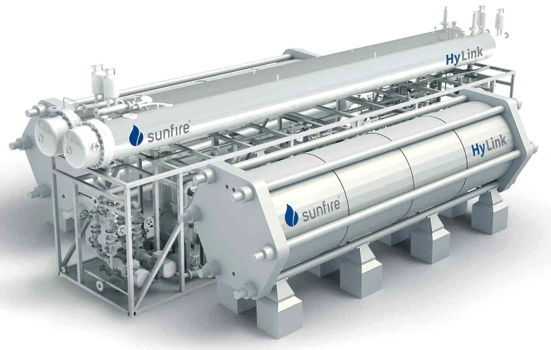
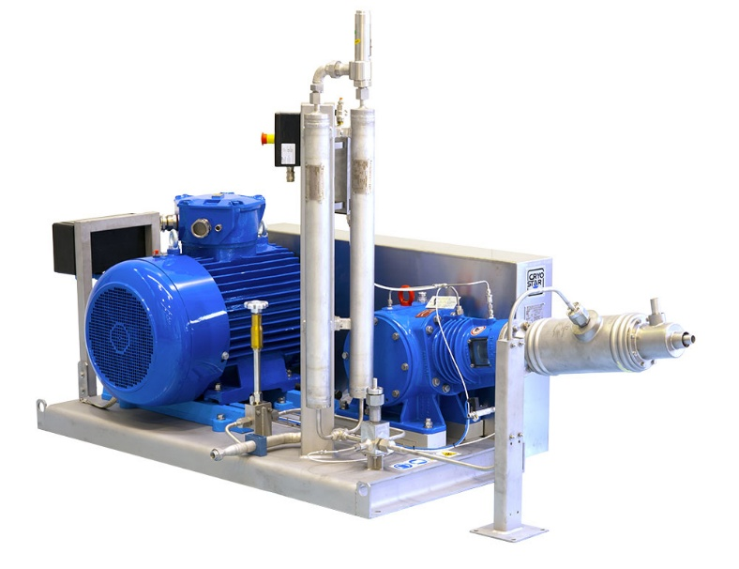
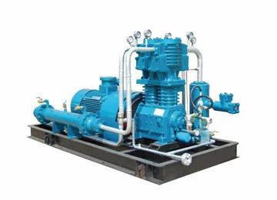
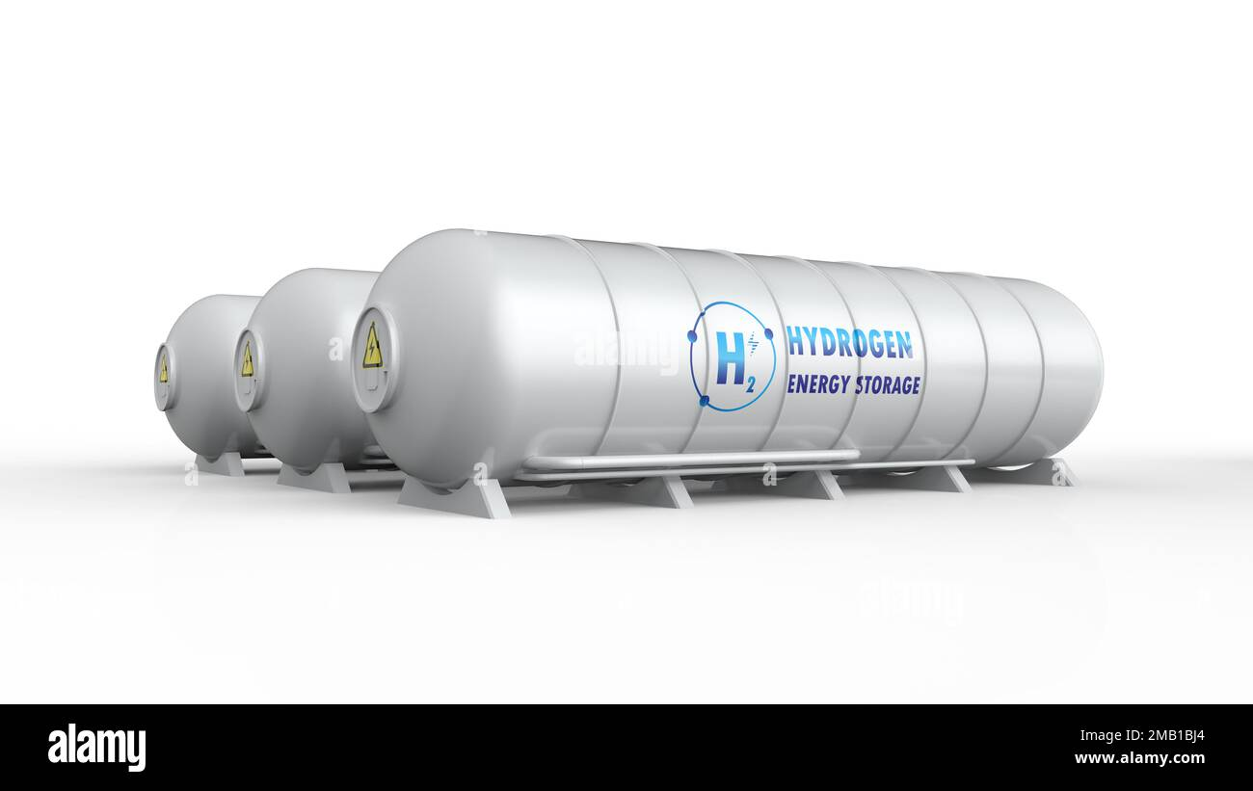
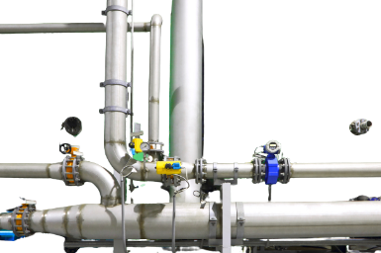


EQUIMENTS USED IN GREEN HYDROGEN
Hydrogen Compressor
Electrolyzer
Hydrogen Pumps
Pipes and Fitting
Storage Tank

Slide 9

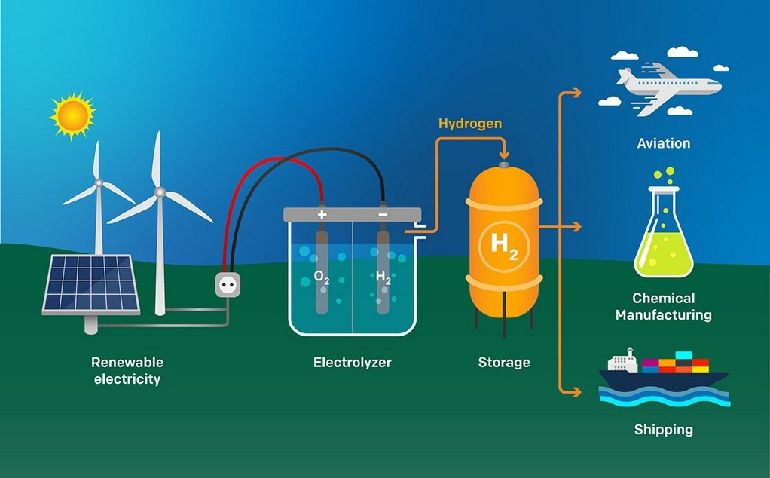

most Commonly component used in production of
green hydrogen is ElectrolyZER
Electrolyzers are crucial components used in green hydrogen production. They operate by splitting water (H2O) into hydrogen (H2) and oxygen (O2) using electrical current.
When electricity is passed through water, it triggers a chemical reaction. This reaction results in the separation of hydrogen gas at the cathode and oxygen gas at the anode.
Key Manufacturers in India: The top manufacturers in India include the AVAADA GROUP and BRISE CHEMICALS. These companies are known for their expertise in producing high-quality electrolyzers for green hydrogen plants.
Components of Electrolyzers : It consist of electrodes, electrolytes, and a membrane. The electrodes, typically made of materials like platinum, titanium, or nickel, facilitate the electrolysis process.

Slide 10





Certification process for Electrolyzer
Determine Certification Requirements:-
Identify specific standards, regulations & certification required for Electrolyzer.
This includes safety standards, performance criteria, & environmental regulations.
Quality Management system:-
Implement a quality management system that complies it ISO 9001 or a relevant standards.
This system should cover the Development & Design and also testing processes.
Testing:-
Conduct various tests to validate the performance and safety of electrolyzer.
These tests include electrical safety tests, efficiency tests and hydrogen purity tests.
Design & Development :-
Design of electrolyser has to meet the safety & performance requirements specified in ISO 22734.
This may include aspects such as electrical safety, hydrogen gas handling, system efficiency, material

Slide 11


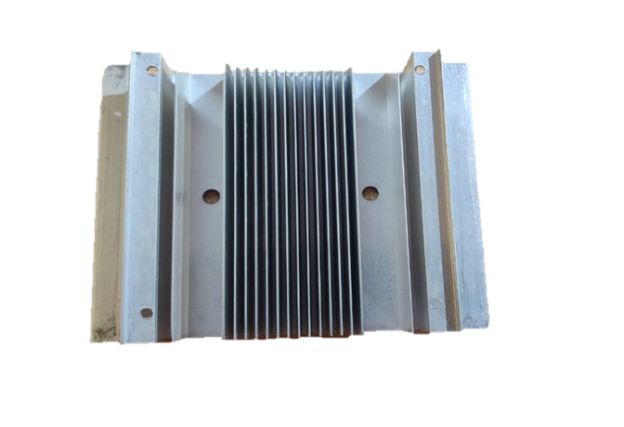
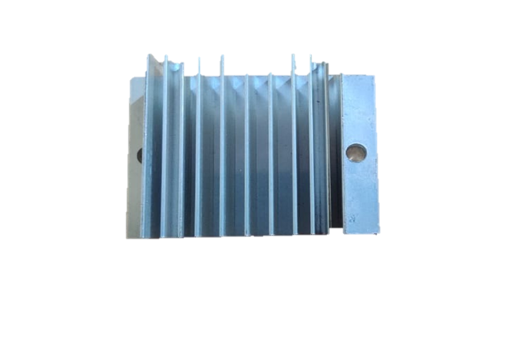



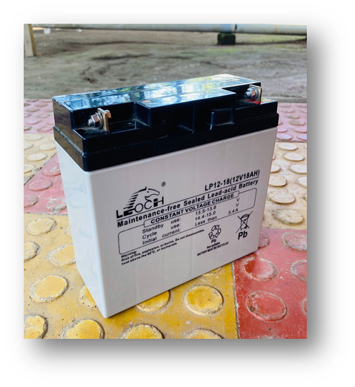
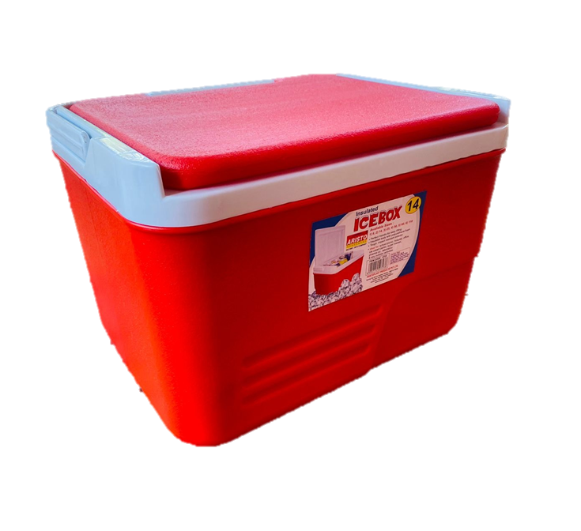





It includes:
Product specifications that outline the tech. details & features of electrolyzer.
Test reports that document the results of the testing and verification processes.
Quality control records that show how electrolyzer maintains consistent quality.
User manuals that provide instructions on the safe and effective use of your electrolyzer.
Documentation:-
Prepare detailed documentation, including User manuals, maintenance guides & technical specification comply with relevant standards.
Application Submission:-
Submit an application for certification to the chosen certification agent.
Application should include all the required documentation and information about electrolyzer. (Incl. onsite audit)
Certification Selection
Choose a certification agent or testing laboratory that is accredited and recognized in your industry and region.
The certification parts should be familiar with the standards and regulations that apply to your product.

Slide 12

Product Evaluation:-
The certification agents will evaluate your product to ensure that it complies with the applicable standards and regulations.
A review of the documentation you submitted to support your application.
The certification agents will assess whether your electrolyzer meets the required safety, performance, and quality standards.
Labelling
After an electrolyzer receives certification, it is labeled with a certification mark, indicating that it meets the required standards.
This allows it to be sold as a certified product, ensuring that it meets safety and quality requirements.
Hence the electrolyzer is certified.
Certification Approval:-
If electrolyze successfully meets all the required criteria, then the certification agents will issue a certification.
This certificate demonstrates that your product complies with the applicable standards.

Slide 13
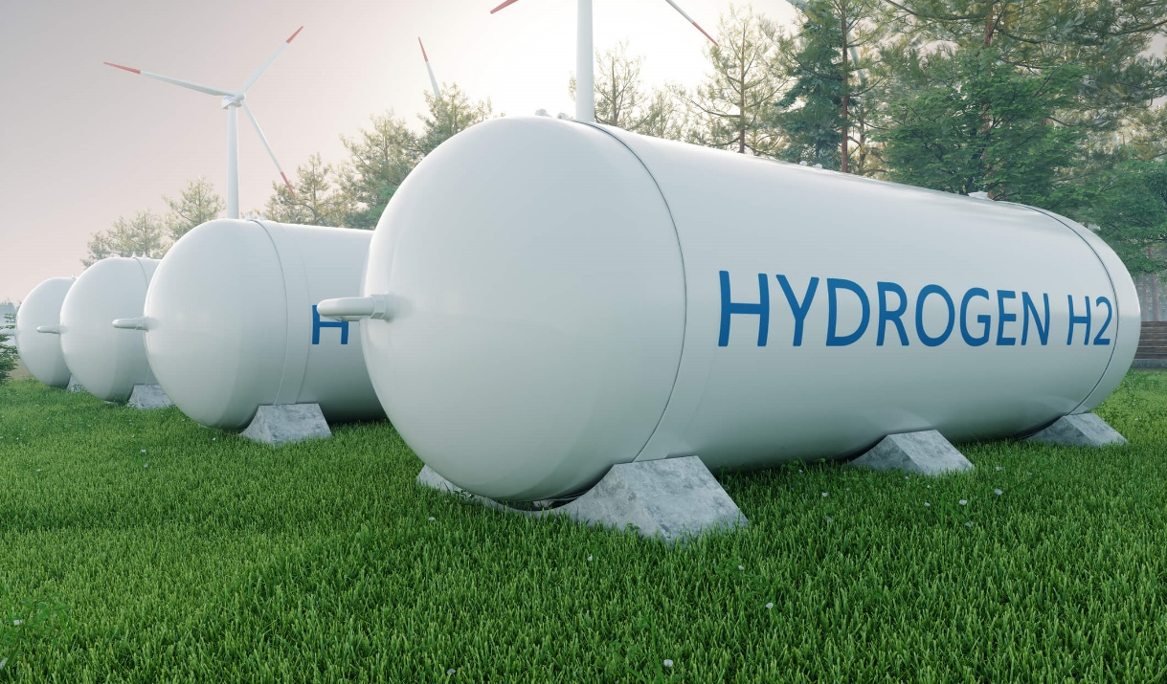
HYDROGEN STORAGE TANK
A green hydrogen storage tank is a specially designed container used to store hydrogen gas. These tanks are engineered to safely store high-pressure hydrogen, often using materials like carbon fiber or reinforced polymers.
Burst Testing : Validates the tank's structural integrity by subjecting it to pressures higher than its maximum operating pressure.
Pressure Range: Typically 1.5 to 2 times the tank's maximum operating pressure or higher.
Material Testing : It Ensures the materials used in tank construction meet mechanical and chemical requirements for handling hydrogen. Common Tests done like Tensile testing, hardness testing, and chemical analysis.
Leakage testing : Detects and prevents leaks that could lead to hydrogen escaping from the tank.
Methods: Visual inspection, pressure decay testing, bubble testing with soapy water, and helium leak detection.
Pressure Testing : Validates the tank's ability to withstand pressure without leaking or rupturing.
Methods: Hydrostatic testing (using water) and pneumatic testing (using compressed air or inert gas)..

Slide 14
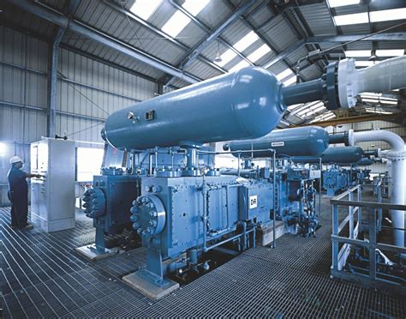
HYDROGEN COMPRESSORS
A hydrogen compressor is a device that takes in hydrogen gas at low pressure and raising its pressure for storage or transport. These compressors are crucial for storing and delivering hydrogen efficiently, especially in applications like fueling stations for hydrogen vehicles or industrial processes requiring high-pressure hydrogen.
Performance Testing: Evaluates the compressor's ability to move hydrogen gas efficiently and increase its pressure as needed for storage. It Measures flow rate (e.g., cubic meters per hour) and pressure increase capability (e.g., bar) under various operating conditions. Performance testing assesses the compressor's effectiveness in handling hydrogen gas, critical for its performance in fueling stations or industrial processes.
Material Compatibility Testing : Ensures compressor materials can withstand exposure to hydrogen without degradation or compromise in performance. It conduct tests like tensile testing, hardness testing, and chemical analysis. It Verifying material compatibility with hydrogen is crucial to ensure long-term reliability and safety of the compressor.
Leakage Testing: It Detects and prevents leaks in the compressor system to ensure gas containment and safety & Utilizes tracer gases like helium or hydrogen and methods such as visual inspection, pressure decay testing, and helium leak detection.
Pressure Testing : Validates the compressor's ability to withstand high pressure without leaking. Utilizes methods such as hydrostatic testing (with water) or pneumatic testing (with compressed air or inert gas) to apply pressure beyond operating limits.

Slide 15
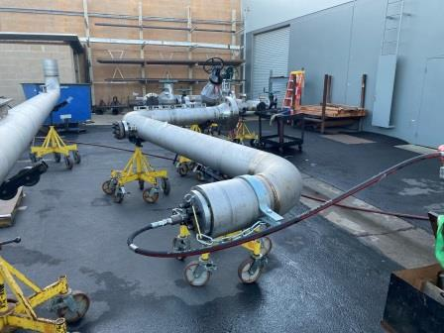
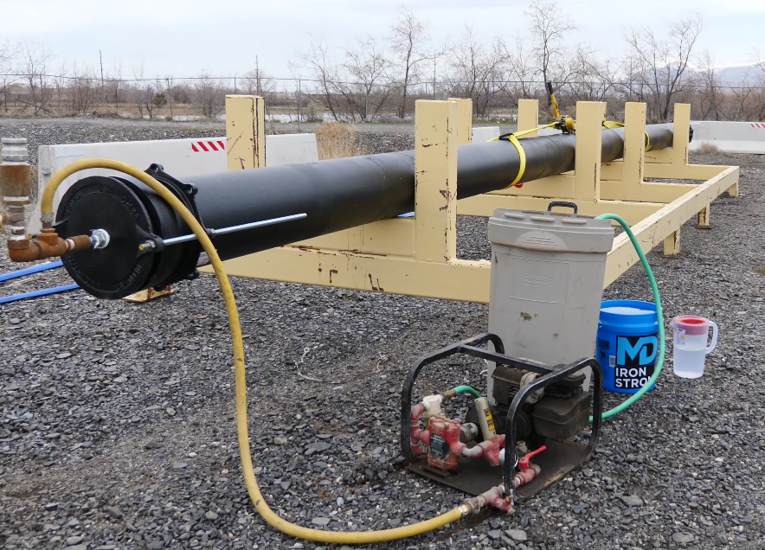
PIPES AND FITTINGS
The pipes and fittings play a critical role in safely transporting hydrogen gas throughout the facility. These components must be carefully engineered and constructed to withstand the unique challenges posed by hydrogen, such as its tendency to embrittle certain metals. Precision in design and material selection is paramount to ensure efficiency, reliability, and, above all, safety in the production process.
Corrosion Testing: Evaluating the resistance of materials to corrosion in hydrogen-rich environments, which can be accelerated by factors such as high pressure, temperature, and impurities in the gas stream.
Pressure Relief Device Testing: Pressure relief devices such as relief valves are tested to ensure they operate effectively and are set to the appropriate pressure levels to prevent over pressurization of the system. Testing involves verifying the opening pressure, flow rate, and response time of the relief devices.
Thermal Cycling Testing: Subjecting pipes and fittings to cycles of rapid temperature changes to assess their ability to withstand thermal stress and prevent cracking or deformation during operation.
Non-destructive Testing (NDT): NDT techniques are utilized to detect flaws or defects in pipes and fittings without causing damage to the material. This includes ultrasonic testing, which uses high-frequency sound waves to detect internal flaws.
Welding Inspection: Welded joints are subjected to inspection to ensure they meet specified standards and are free from defects such as cracks, porosity, or incomplete fusion. Techniques such as visual inspection, ultrasonic testing, radiographic testing, and magnetic particle testing are commonly employed for weld inspection.

Slide 16
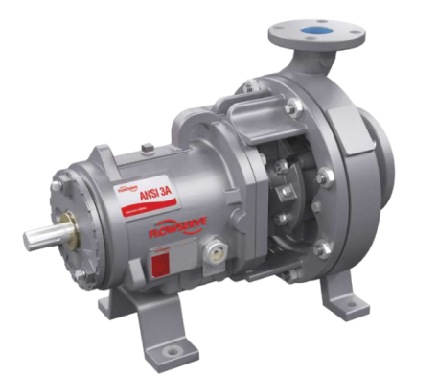
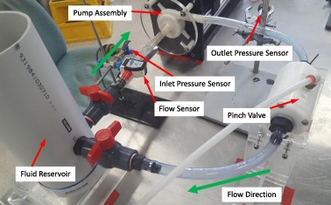
PUMPS
Pumps in hydrogen production plants are essential for transferring hydrogen gas between various stages of the production process, such as purification, compression, and storage.
Vibration and Mechanical Testing: Assessing the pump's ability to withstand vibrations and mechanical stresses during operation, ensuring durability and reliability under dynamic conditions
Hydrogen Compression Efficiency Testing: Evaluating the efficiency of the pump in compressing hydrogen gas to the desired pressure levels, ensuring optimal energy usage and minimizing losses during the compression process.
Emergency Shutdown Testing: Testing the pump's response to emergency shutdown procedures to ensure it can quickly and safely halt operation in the event of an emergency or system malfunction.
Leakage Testing: Conducting tests to detect and quantify any leaks in the pump system, ensuring tight seals and connections to prevent hydrogen leakage, which can pose safety hazards and decrease system efficiency.
Some other Tests:
Start-up and Shutdown Testing
heat Dissipation Testing
Pressure Testing
Seismic Testing

Slide 17
LIMITED TEMPERATURE RANGE
HIGH INITIAL COST
CODES AND STANDARDS FOR EQUIPMENTS
DEPENDENCE ON WEATHER CONDITIONS
Sr.no | EQUIPMENTS | CODES | DESCRIPTION | LOCATION TO APPLY
1. | Electrolyzer | ISO 22734 (2019) | It covers safety, construction, operation, routine testing of electrolyser. | TUV India Pvt Ltd: Nityanand Nagar, Ghatkopar West, Mumbai, Maharashtra 400086 Website: Tuvsud.in
2. | Storage Tanks | ISO 2825 (1971) | Provide guidelines for design and construction, fabrication, testing and inspection. | TÜV SÜD South Asia, Mumbai - Branch Office, Andheri (East), Mumbai, 400072, Maharashtra
3. | Pipes and Tubing | IS0 1239 (2004) | Specification and testing of welded and seamless carbon steel pipes | Envirocare labs Pvt.Ltd Branch: Thane:(A-7) enviro house, MIDC.
LIMITED COOLING CAPACITY
LESS COP

Slide 18

LIMITED TEMPERATURE RANGE
HIGH INITIAL COST
CODES AND STANDARDS FOR EQUIPMENTS
Sr.no | EQUIPMENTS | CODES | DESCRIPTION | LOCATION TO APPLY
4. | Hydrogen Pumps | ISO 19880-1:2018 | This standard specifies handling, testing, calibration and measurement techniques. | TUV India ( Mumbai, Pune, Hyderabad, Ahmedabad ) Intertek India (Mumbai, Delhi, Chennai, Kolkata, Vadodara,
5. | Hydrogen Compressor | ISO 11114 | This standard ensures that materials used in hydrogen compressors resist degradation, embrittlement, and corrosion, ensuring safe and reliable operation. | NABL accredited laboratories & specialized testing facilities across major industrial cities in India, such as Mumbai, Chennai, and Delhi.
6. | Hydrogen pressure gauge | ISO 3624 (1987) | This standard provides the specification for pressure and vacuum gauges. | ELCA Laboratories Testing laboratories in India, with labs in Navi Mumbai, pune.
DEPENDENCE ON WEATHER CONDITIONS
LIMITED COOLING CAPACITY
LESS COP

Slide 19



RESULTS
After undergoing our detail certification process, the equipment used in green hydrogen production achieves a High level of quality and safety.
This certification not only ensures compliance with industry standards but also opens doors to broader market.
Also certified equipment's ensures workers safety and maintain safe environment during working.
Certified equipment can now be confidently sold in both commercial markets and to government organizations, providing a significant competitive edge in the rapidly growing green hydrogen industry.

Slide 20
REFERENCES
TÜV SÜD. Green Hydrogen Certification - Hydrogen Services That Enable Safety for Your Ideas. https://www.tuvsud.com/en-in/themes/hydrogen/hydrogen-services-that-enable-safety-for-your-ideas/green-hydrogen-certification
DNV. Certification of Green Hydrogen Production Systems. https://www.dnv.com/article/certification-of-green-hydrogen-production-systems-211452
Green Hydrogen Coalition. Advancing Green Hydrogen as a Clean Energy Solution. https://greenhydrogencoalition.org/
National Renewable Energy Laboratory (NREL). Hydrogen Research Publications and Reports. https://www.nrel.gov/

Slide 21


